Slide 1
Reading

Slide 2
Lesson Objectives
Understand and discuss how error messages are structured
Utilize software documentation to implement a solution

Slide 3
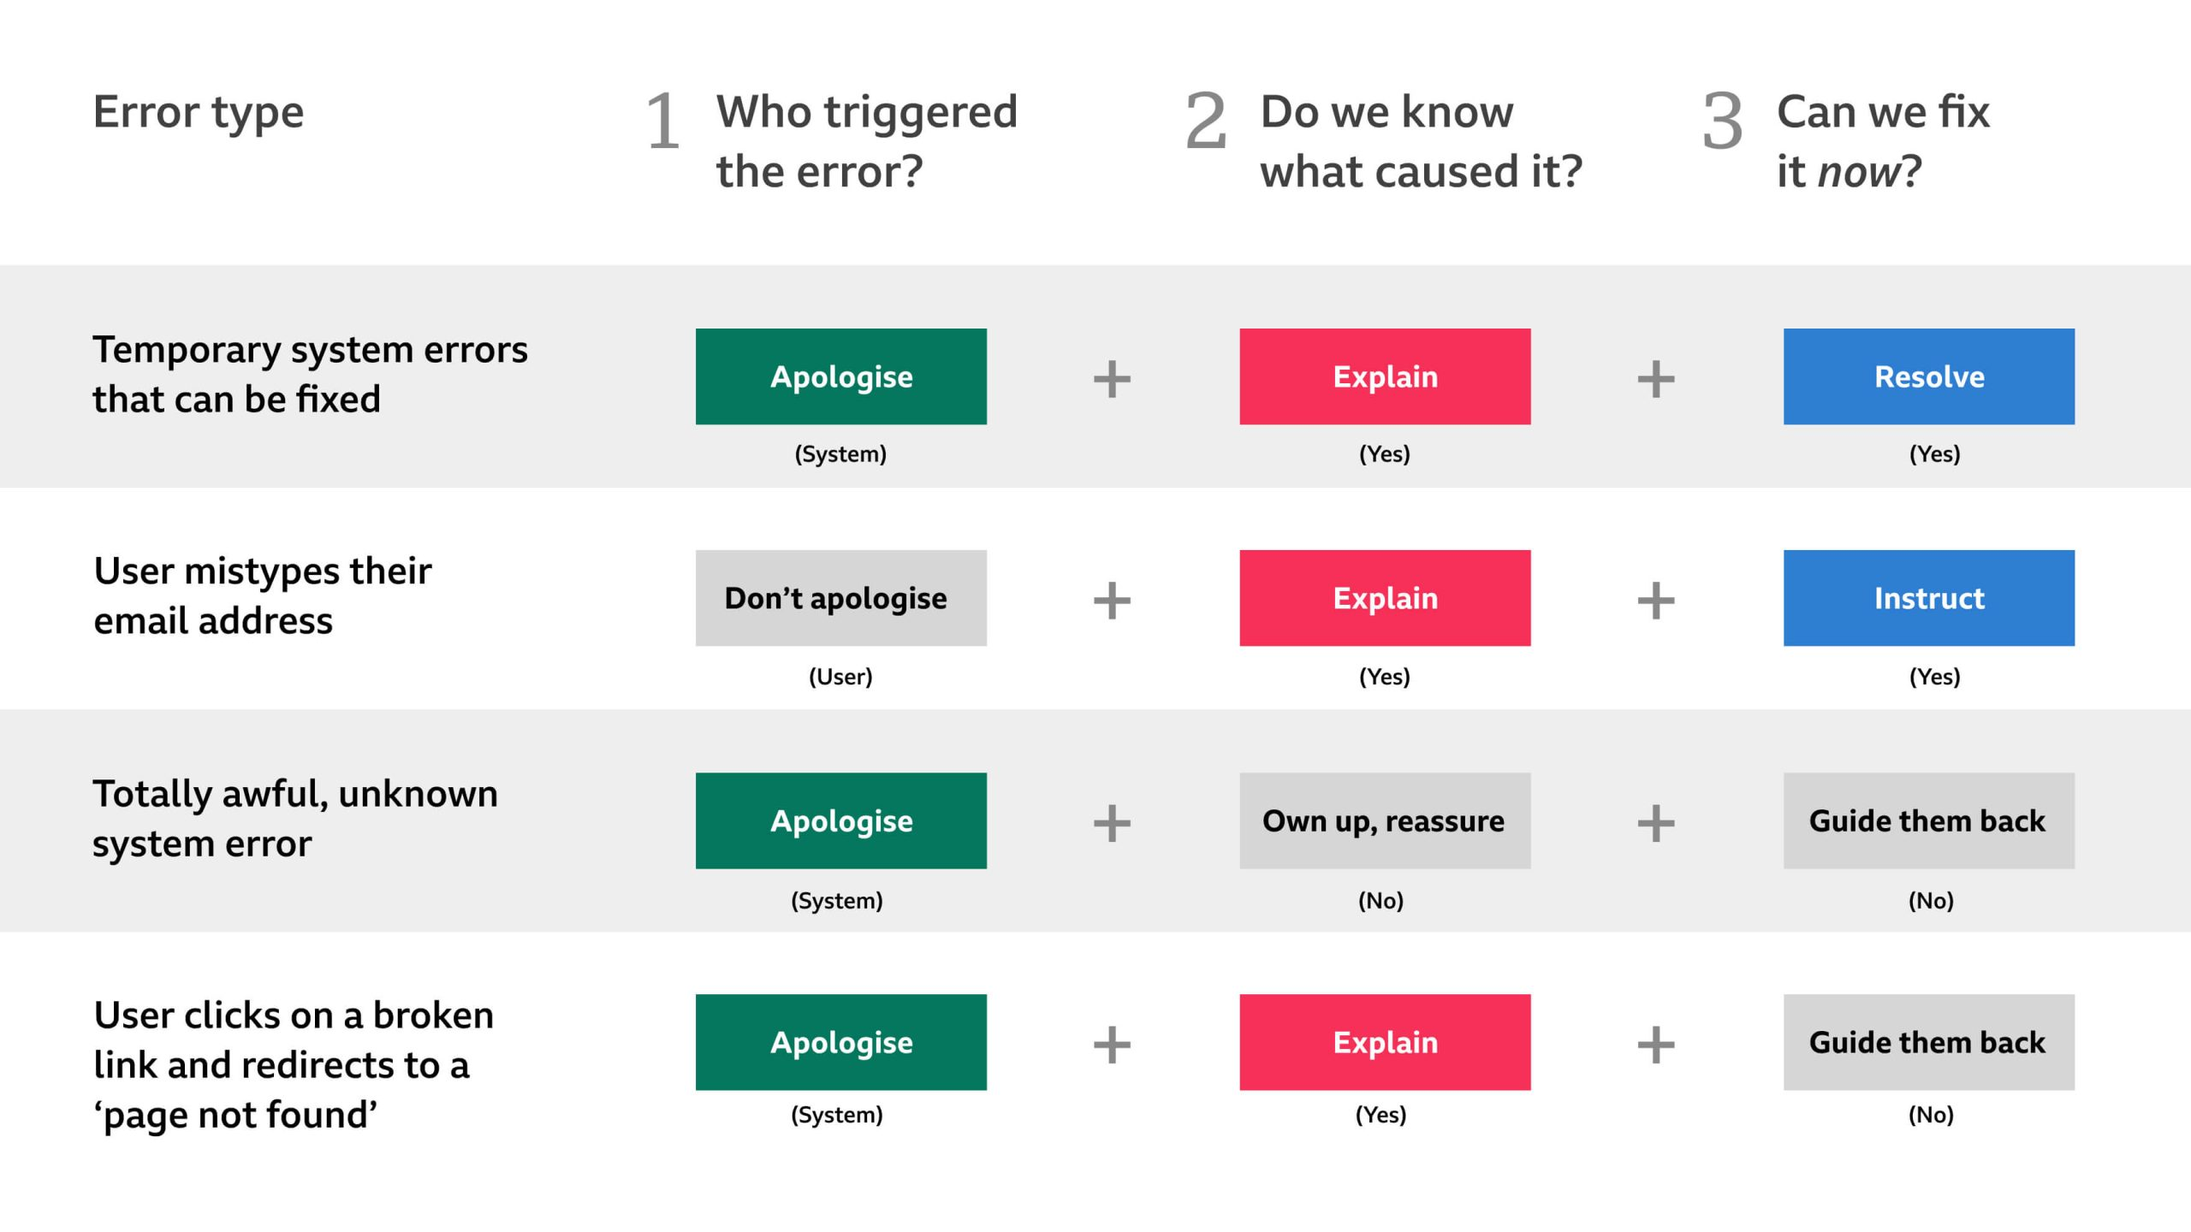
UI / UX
Applications need to present information to the user…
In a GUI → pop-up
In a CLI…
Some messages are useful, some are not

Slide 4
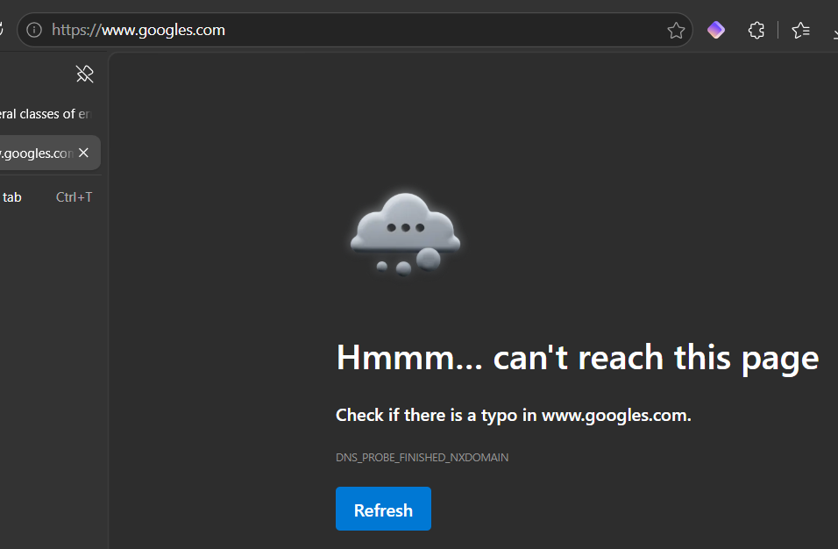
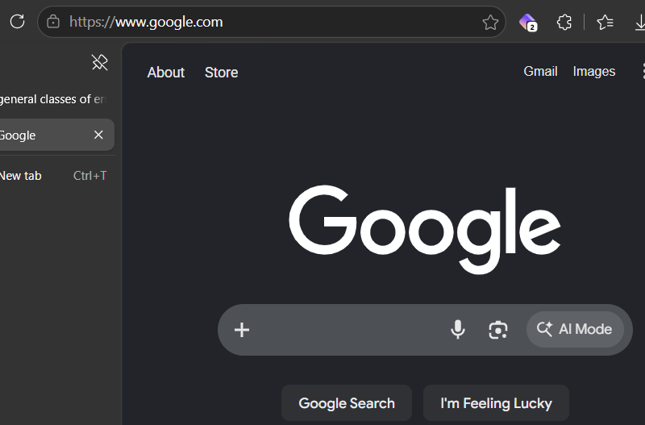
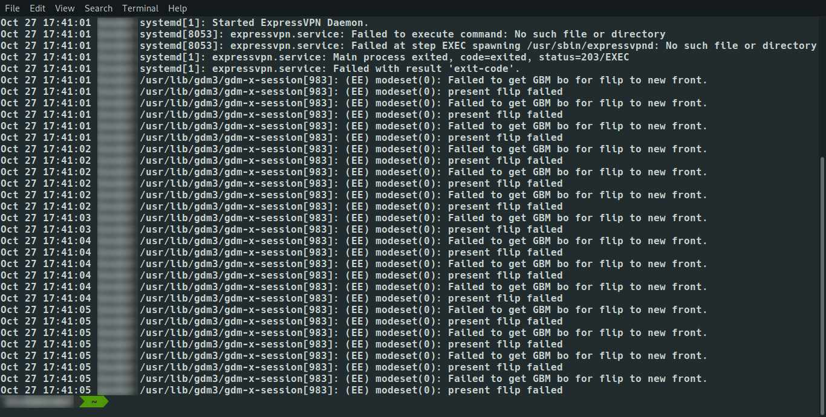
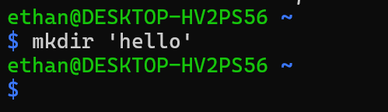
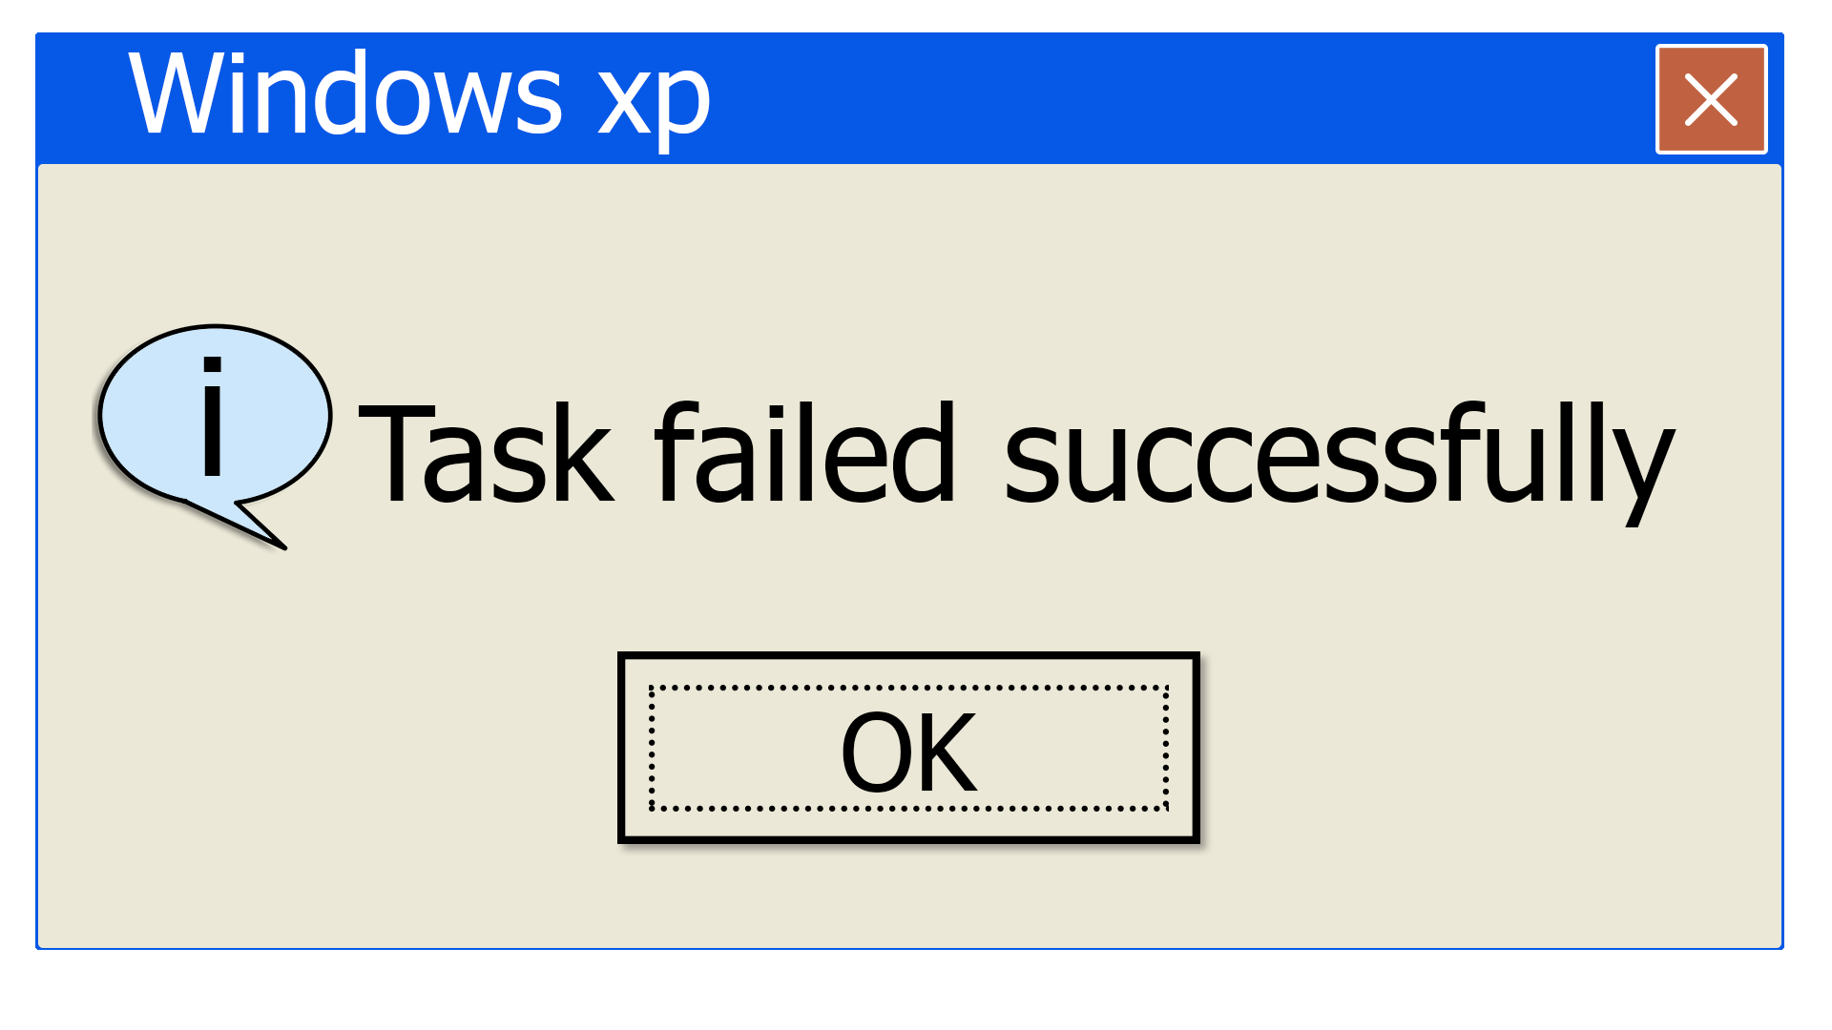
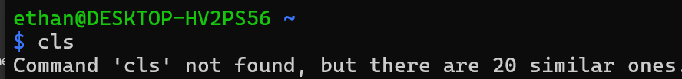
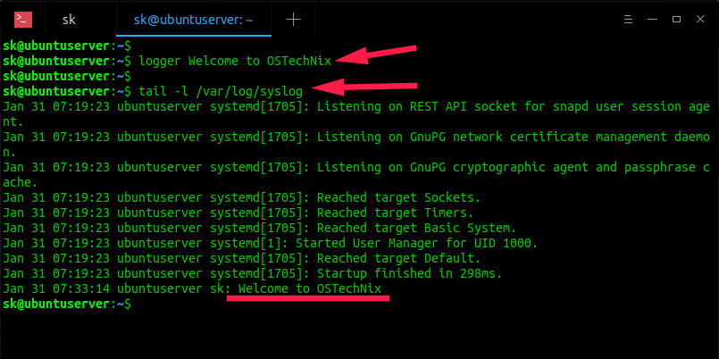
To Be Success… Or Not To Be Success…

Slide 5
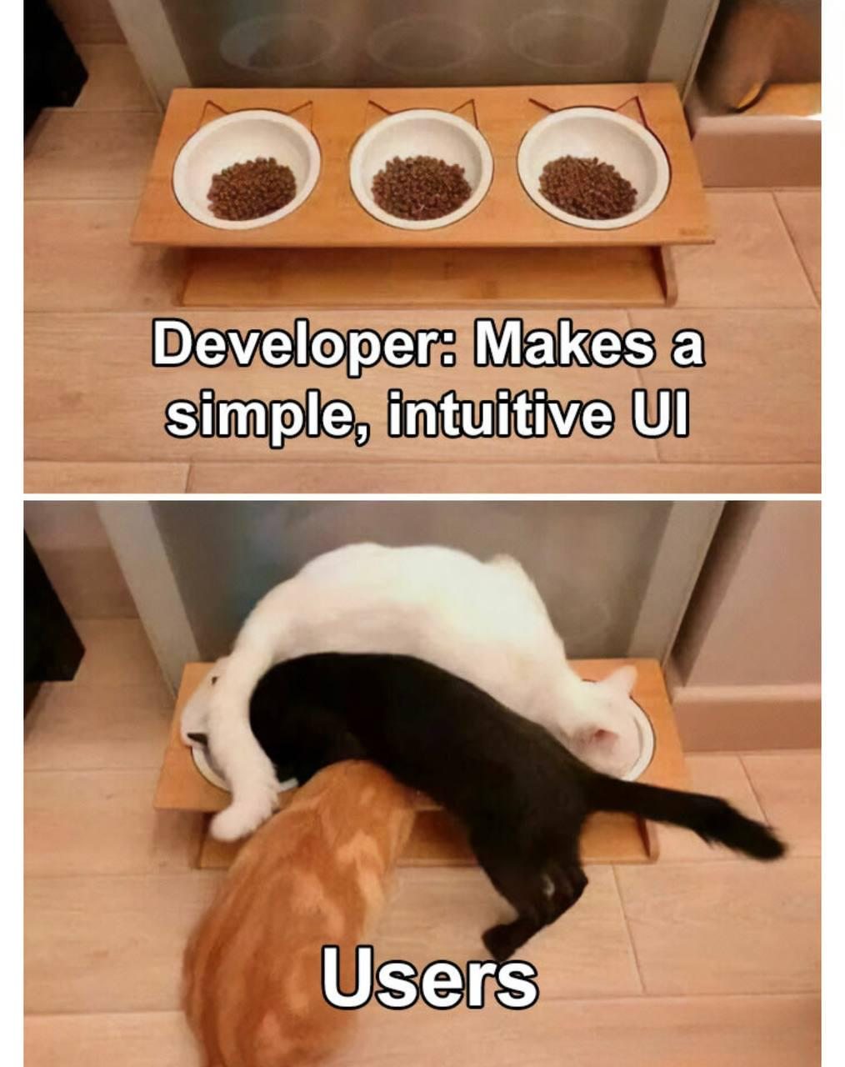
Messages
All UI/UX come from software
Software is written by humans
Humans are… human
Cannot anticipate all outcomes
Cannot anticipate the myriad of ways users will mess it up
Sometimes wrong! 🤷

Slide 6
(Error) Messages
General types:
Programming/software
Syntax
Runtime
Logic
Permissions
Resource
Action
Data
Integrity
Format
Time-based
Deadlock
Timeout
Severity
Critical
Warning
Informational
The context changes if you’re a developer or user

Slide 7
Examples…
General types:
Programming/software
Syntax
Runtime
Logic
Permissions
Resource
Action
Data
Integrity
Format
Time-based
Deadlock
Timeout
[INFO] Parsing configuration file... [ERROR] Unexpected token '}' at line 42. [ERROR] Parsing aborted. [INFO] Application terminated.

Slide 8
Examples…
General types:
Programming/software
Syntax
Runtime
Logic
Permissions
Resource
Action
Data
Integrity
Format
Time-based
Deadlock
Timeout
[INFO] Processing request #1287... [ERROR] NullReferenceException: Object reference not set to an instance of an object. Stack trace: at UserService.GetProfile()

Slide 9
Examples…
General types:
Programming/software
Syntax
Runtime
Logic
Permissions
Resource
Action
Data
Integrity
Format
Time-based
Deadlock
Timeout
[INFO] User requested 'Delete Project’. [ERROR] User not authorized to ‘delete’.

Slide 10
Examples…
General types:
Programming/software
Syntax
Runtime
Logic
Permissions
Resource
Action
Data
Integrity
Format
Time-based
Deadlock
Timeout
[INFO] Saving new order... [ERROR] Foreign key constraint violation. Customer ID '9821' does not exist. [INFO] Database transaction rolled back.

Slide 11
Examples…
General types:
Programming/software
Syntax
Runtime
Logic
Permissions
Resource
Action
Data
Integrity
Format
Time-based
Deadlock
Timeout
[INFO] Connecting to remote service... [INFO] Waiting for response... [ERROR] Request timed out after 30 seconds.

Slide 12
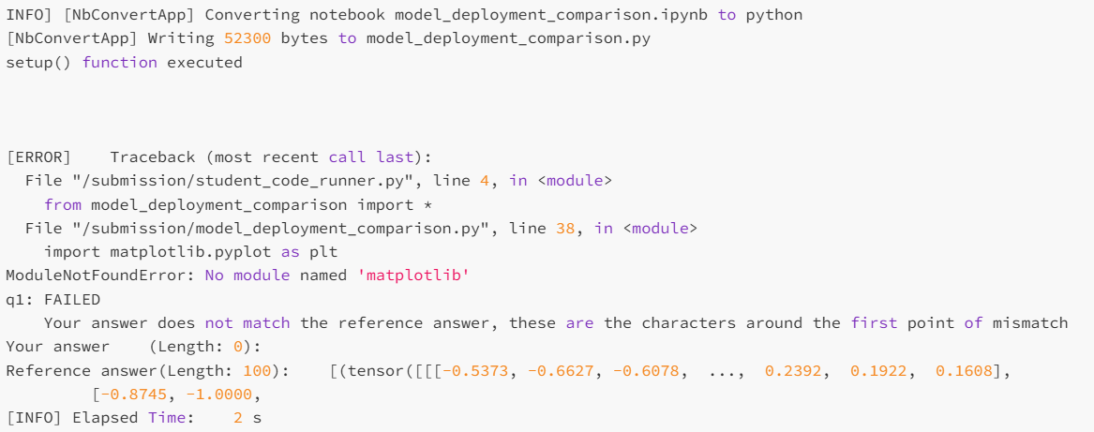
Spot the Issue…
Notes:
These next three slides are real errors from AI Techs

Slide 13
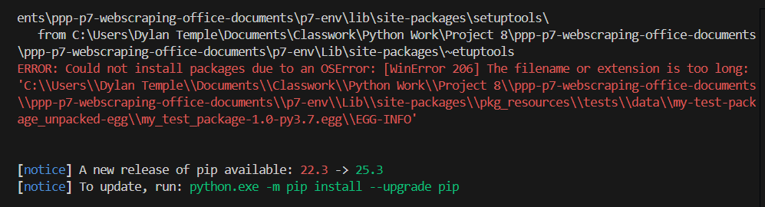
Spot the Issue…

Slide 14
Spot the Issue…
│ Error: creating App Service Plan (Subscription: <subscription-id>│ Resource Group Name: "continuous-monitoring-rg-48343"│ Server Farm Name: "webapp-asp-2023-48343"): performing CreateOrUpdate: unexpected status 409 (409 Conflict) with response: {"Code":"Conflict","Message":"The pricing tier 'Isolated' is not allowed in this resource group. Use this link to learn more: https://aka.ms/app-service-plan-scale-not-allowed","Target":null,"Details":[{"Message":"The pricing tier 'Isolated' is not allowed in this resource group. Use this link to learn more: https://aka.ms/app-service-plan-scale-not-allowed"},{"Code":"Conflict"},{"ErrorEntity":{"ExtendedCode":"04114","MessageTemplate":"The pricing tier '{0}' is not allowed in this resource group. Use this link to learn more: https://aka.ms/app-service-plan-scale-not-allowed","Parameters":["Isolated"],"Code":"Conflict","Message":"The pricing tier 'Isolated' is not allowed in this resource group. Use this link to learn more: https://aka.ms/app-service-plan-scale-not-allowed"}}],"Innererror":null}│ │ with azurerm_service_plan.appserviceplan,│ on main.tf line 71, in resource "azurerm_service_plan" "appserviceplan":│ 71: resource "azurerm_service_plan" "appserviceplan" {│ │ creating App Service Plan (Subscription: <subscription-id>│ Resource Group Name: "continuous-monitoring-rg-48343"│ Server Farm Name: "webapp-asp-2023-48343"): performing CreateOrUpdate: unexpected status 409 (409 Conflict) with response: {"Code":"Conflict","Message":"The pricing tier 'Isolated' is not allowed in this resource group. Use this link to learn more: https://aka.ms/app-service-plan-scale-not-allowed","Target":null,"Details":[{"Message":"The pricing tier 'Isolated' is not allowed in this resource group. Use this link to│ learn more: https://aka.ms/app-service-plan-scale-not-allowed"},{"Code":"Conflict"},{"ErrorEntity":{"ExtendedCode":"04114","MessageTemplate":"The pricing tier '{0}' is not allowed in this resource group. Use this link to learn more: https://aka.ms/app-service-plan-scale-not-allowed","Parameters":["Isolated"],"Code":"Conflict","Message":"The pricing tier 'Isolated' is not allowed in this resource group. Use this link to│ learn more: https://aka.ms/app-service-plan-scale-not-allowed"}}],"Innererror":null}

Slide 15
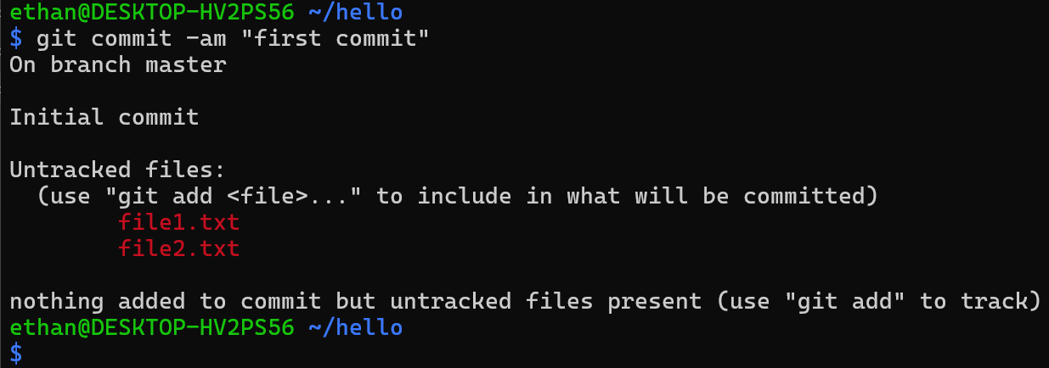
Spot the Issue…

Slide 16
General Strategies
Bottom-up
Top-down
Bottom, top, down
Skim to error
Chronological
2026-07-08 10:14:22 [INFO] User login initiated. 2026-07-08 10:14:23 [INFO] Connecting to database... 2026-07-08 10:14:28 [ERROR] Connection timed out after 5 seconds. 2026-07-08 10:14:28 [INFO] Retrying connection... 2026-07-08 10:14:34 [INFO] Connection established. 2026-07-08 10:14:35 [INFO] Loading user profile... 2026-07-08 10:14:35 [ERROR] Permission denied: User lacks PROFILE_READ permission. 2026-07-08 10:14:35 [INFO] Returning HTTP 403 Forbidden.

Slide 17
Hands-On #1

Slide 18
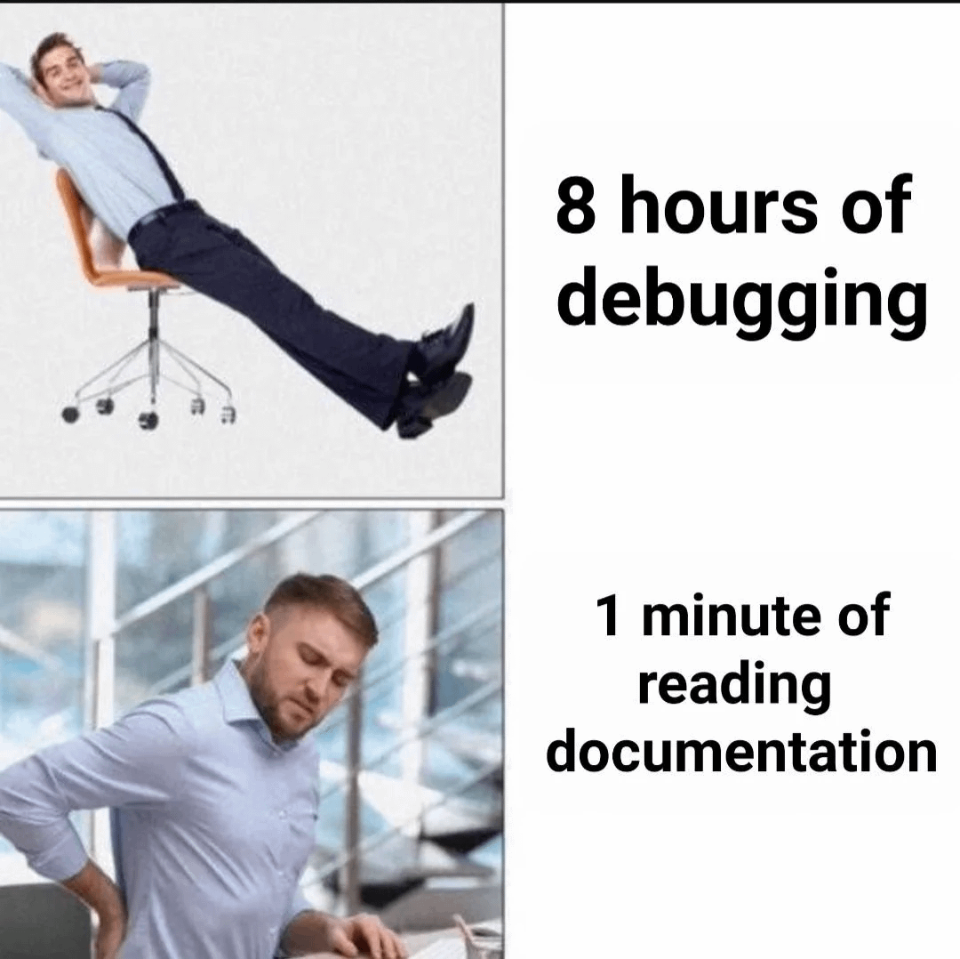
Documentation
Read with a purpose
Be like Goldilocks when you’re skimming
Slow is smooth…

Slide 19
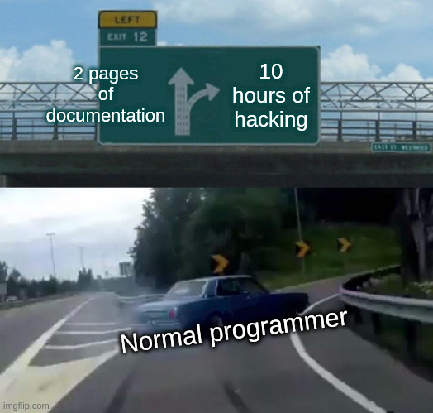
Command Line
[command] --help
man [command]

Slide 20
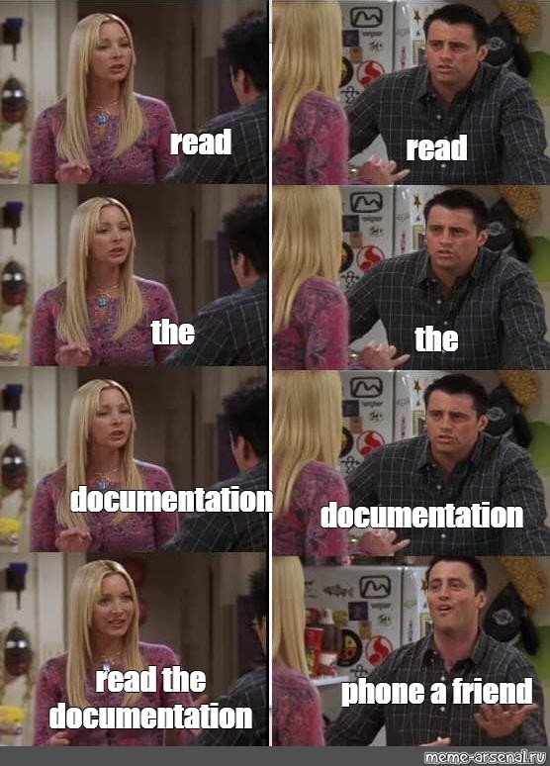
CLI Examples

Slide 21
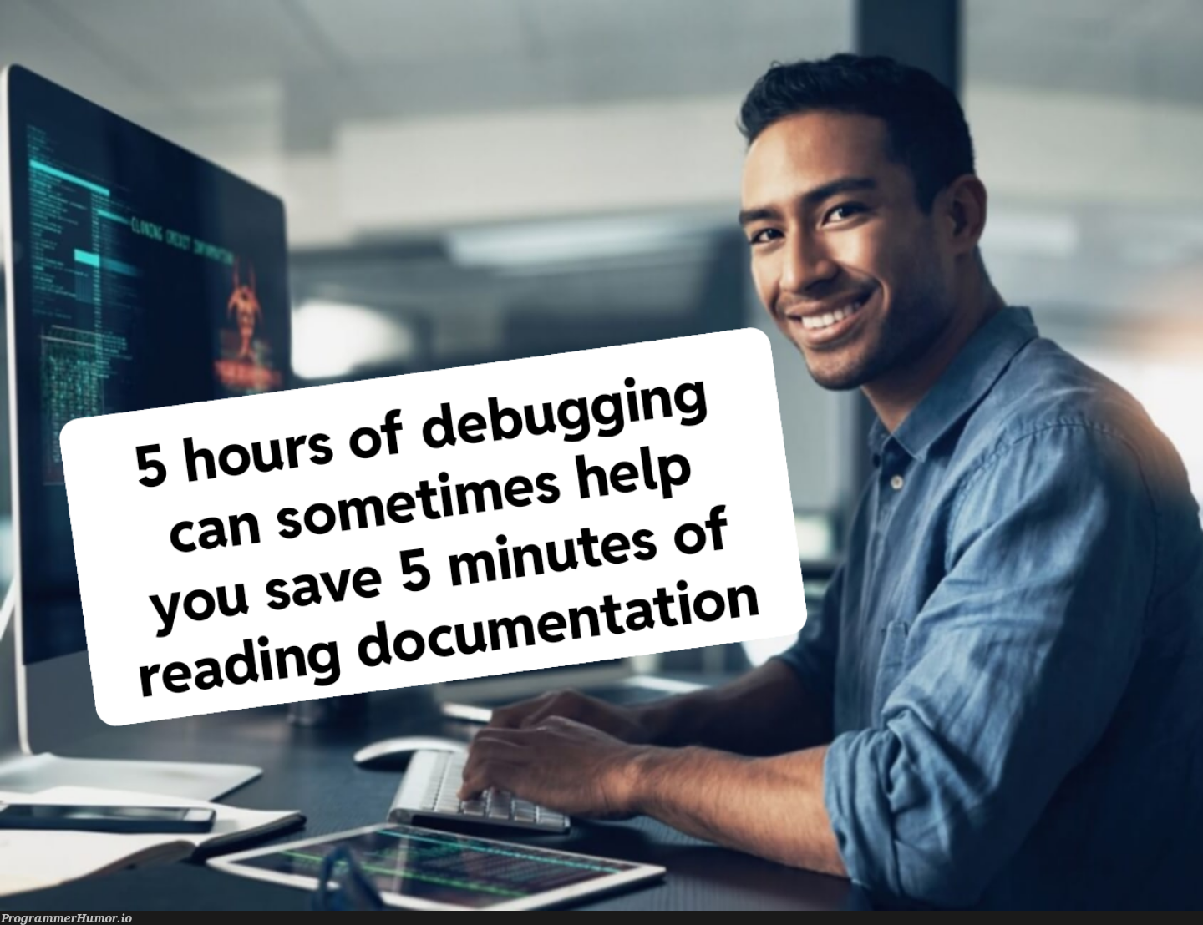
Online
Best to refer to official docs
If official docs are not “readable”, defer to official tutorials
Then online tutorials / guides

Slide 22
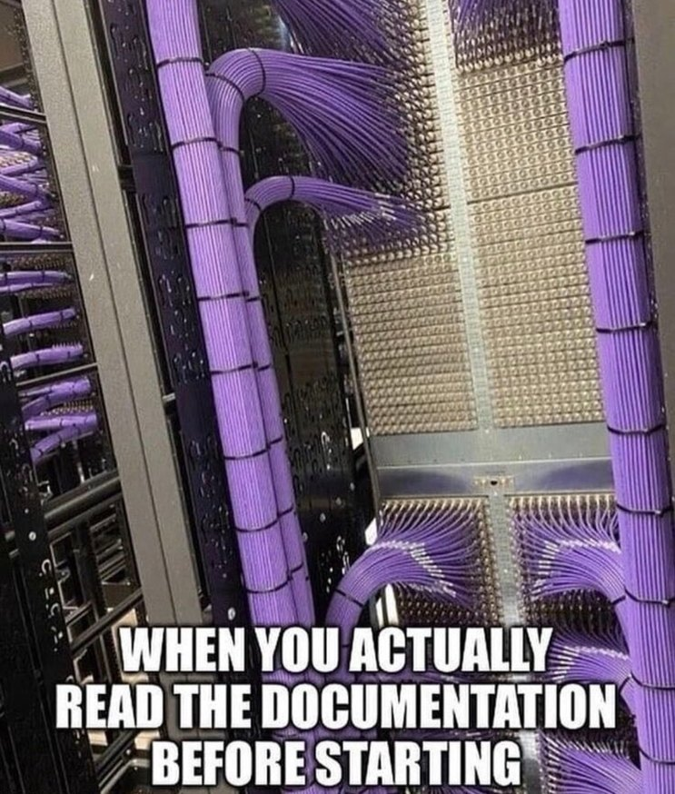
Online Examples
Built-in Functions — Python 3.14.6 documentation
Docker Docs
Azure Command-Line Interface (CLI) documentation | Microsoft Learn

Slide 23
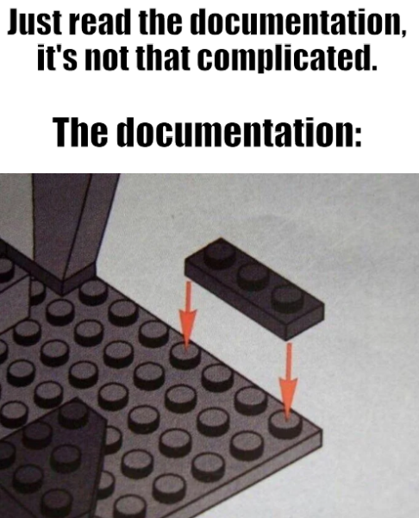
Truth in Lending
All UI/UX come from software
Software is written by humans
Humans are… human
Cannot anticipate all outcomes
Cannot anticipate the myriad of ways users will mess it up
Sometimes wrong! 🤷

Slide 24
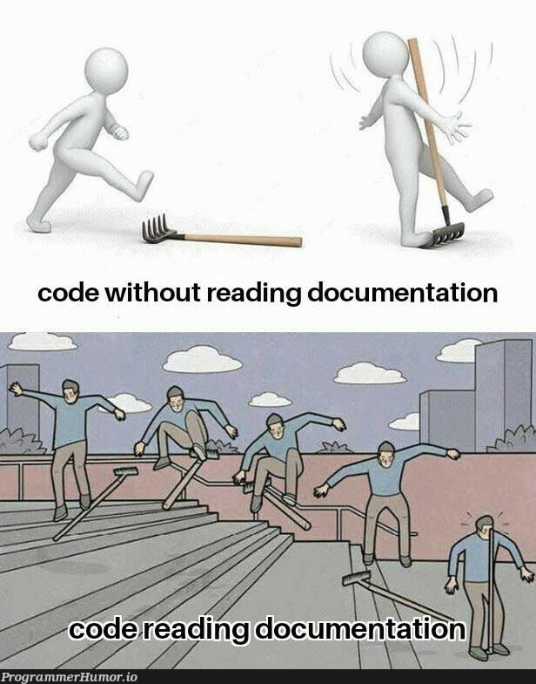
Following Documentation
Precision matters
Order matters
Slow is smooth…
Validate where possible

Slide 25
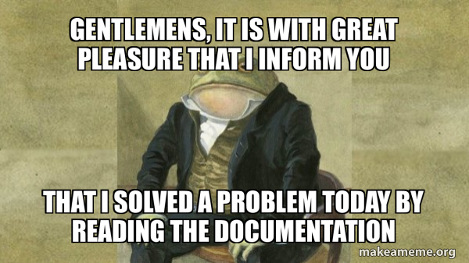
Hands-On #2

